Slide 1

Artist Run-Spaces
Presented by Group 1

Slide 2
Table of Contents
Problem Statement
Objectives
Datasets
Methodology
Descriptive analysis
Perspectives
Project management

Slide 3
Problem Statements
Classify and categorize spaces based on their specific characteristics.
Providing generic tools to make exploration data more accessible and discoverable for both professionals and amateurs.
Notes:
Comment utiliser la science de données pour comprendre les ars

Slide 4
Objectives
Main
Specific
Develop an exploratory NLP-based tool to analyze and visualize topics in Artist Run Spaces description
Topic modeling techniques
Visualization
Annotation and Classification

Slide 5
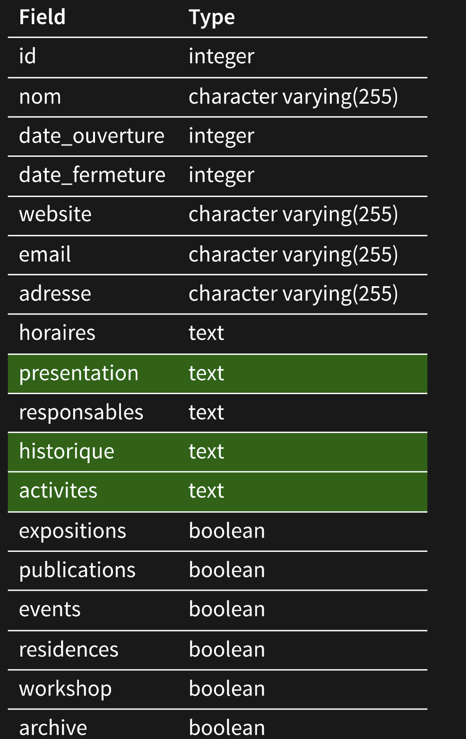
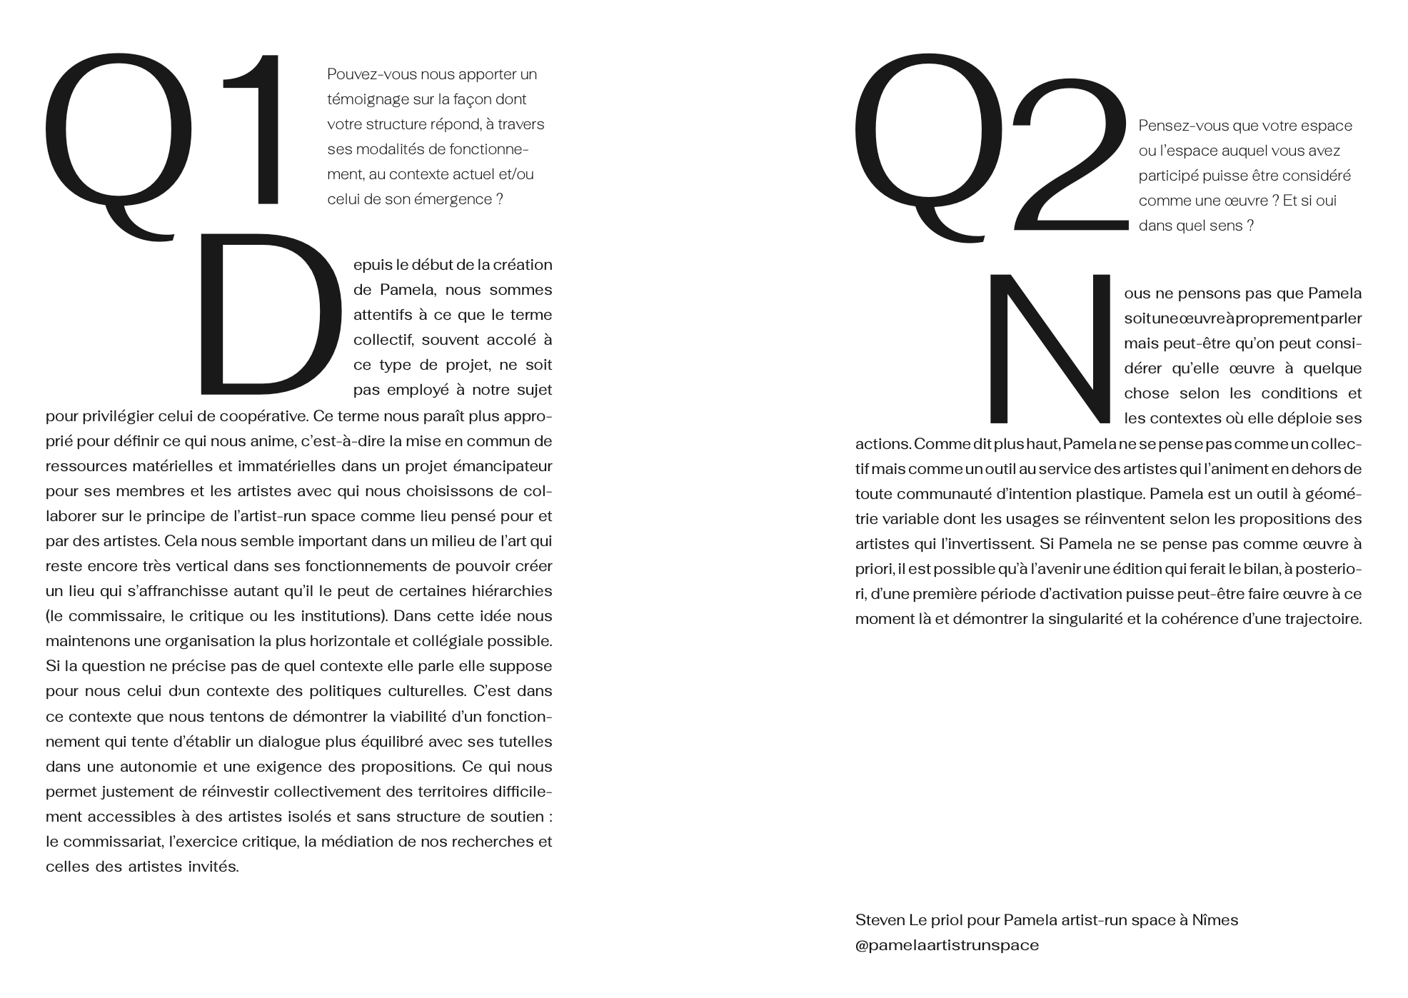
Datasets
Notes:
Les trois champs presentation, historique, activités sont les infos textueles principales . A cela s’ajoute reponse 1 et 2 extrait du questionnaire
Les autres champs sont des informations complementaires
300 entrées (bcp de champs vide )

Slide 6
Methodology

Slide 7
Methodology
Word cloud
Analysis with NLTK
LDA
BertTopic

Slide 8
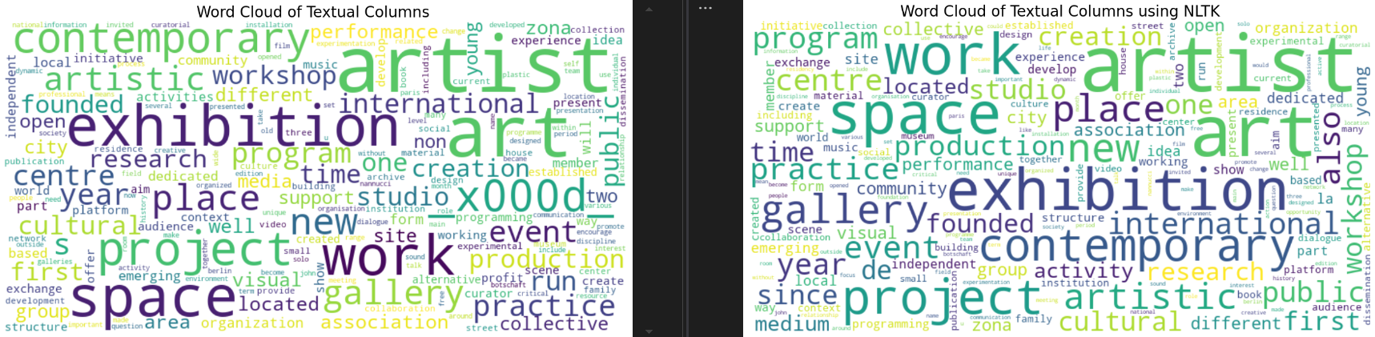
Descriptive Analysis

Slide 9
Descriptive Analysis
Jerome : Lda et berttopic

Slide 10
Perspectives
Exploratory Tool:
BertTopic
Visualization of clusters (themes, keywords, etc.)
Graphs of semantic relationships
- Suggest annotations (classes)
- Pipeline to generalize annotations

Slide 11
Project management

Slide 12
Thank you

